Slide 1

GRADUATION PROJECT
ENCS530
Supervised By: Dr. Hanna Bullata
June 2022

Slide 2
Hello!
Sondos Araj - 1172290
Wafaa Foqahaa - 1172108
Yara Khourieh - 1171564

Slide 3
Perception to Action
Visually Guiding a Robot Gripper to Grab Objects Using OpenCV Library under ROS Operating System

Slide 4
.1
PROJECT IDEA
.5
MASK-RCNN MODEL
.2
INTRODUCTION
TABLE OF CONTENTS
6.
TEXT EXTRACTION
.3
LITERATURE REVIEW
7.
SIMULATED RESULT
.4
Book Boundary Detection
8.
CONCLUSION

Slide 5
1.
PROJECT IDEA

Slide 6
Our Project Idea
Librarian robot for Birzeit University Library.
Help librarians and students.
Capture bookshelves.
Extract book title
If the desired book is found, the robot gripper grab the book.
ROS operating system, GAZEBO and RVIZ and sensors.

Slide 7
2.
INTRODUCTION

Slide 8
What is a Robot?

Slide 9
Robots Components and Types
Components:
Control system
Sensor
Actuator
Power supply
End Effectors
Types:
Pre-programmed Robots
Humanoid Robots
Automated Robots
Tele-operated Robots
Augmenting Robots

Slide 10
3.
LITERATURE REVIEW

Slide 11
Literature Review
A lot of research on autonomous and semi-autonomous robots.
Service robots classification:
Professional service robots.
Personal service robots.
Service robots job:
Assist with housework.
Search and monitor.
Assist people with special needs.
Used for dangerous or impossible manual tasks..

Slide 12
Literature Review
Research is still active in the field of robotics.
Robots designed to perform library tasks are still relatively rare.
An autonomous solution for librarian robots is presented.
Extract a book requested by a user from the bookshelf if this book is located.

Slide 13
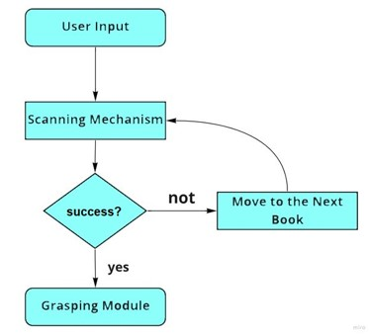
Librarian Robot Overall System Description
Figure 1: System functionality flow chart

Slide 14
Gripping Operation Analysis
Gripper design depends on:
Maximum book size and weight and minimum thickness.
Maximum shelf depth.
The book grasping process involves two main steps:
Pick up the book.
Reposition it.

Slide 15
UJI Robot
The UJI (i.e. the acronym of the University Jaume-I, Castellón, Spain)
Librarian robot designed to help with daily tasks (service robot).
Contains a prototype mobile manipulator.
At first, it employed as an assistant in public libraries
Look for books on the shelves, collect them and transport them to a certain place.

Slide 16
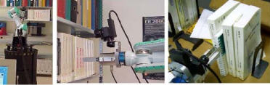
UJI Design Requirements
Camera in hand (MEGA-D Megapixel Digital Stereo Head).
Robot arm (Mitsubishi PA-10, 7 DOF parallel jaw gripper).
Mobile platform (Nomadic) → (ActivMedia PowerBot).
266 MHz Pentium II Processor → 1.2 GHz Pentium IV Processor.
Tactile sensors added on the robot's fingertips.
Figure 2: The system in action. (M. Prats et al., 2004)

Slide 17
Hough transform (Line Detection method)
Traditional method for boundary detection.
Hough transform is a common line detection approach use to detect book boundaries in order to extract individual books.
Accuracies are not always enough.

Slide 18
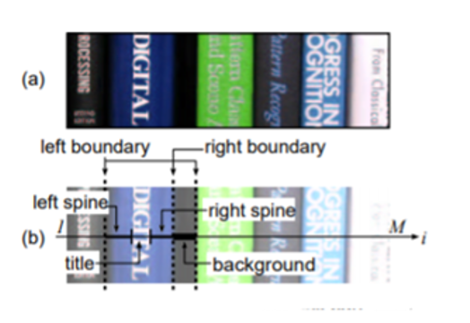
Model-based Book Boundary Detection
A novel technique to extract individual book titles from bookshelf images.
This technique employs a bookshelf model to improve the detection accuracy.
The model is intended to describe the structural aspects of bookshelves.
The components of a bookshelf are: boundary, spine, title and background.
This technique is composed of two steps:
The component and slant angle are optimally estimated at each horizontal position of a bookshelf image, and then the individual book images are isolated.
The book title is extracted from each book image isolated by the first step.
Figure ‎4: Bookshelf image

Slide 19
4. Book Boundary Detection

Slide 20
Several methods based on bookshelf image analysis have been investigated.
Detecting the boundaries of each book in the image simplifies the text extraction process.
The latest technology in image segmentation is Mask R-CNN.
In this context, the stages of development of Mask R-CNN will be presented, starting from Convolutional Neural Networks (CNN).

Slide 21
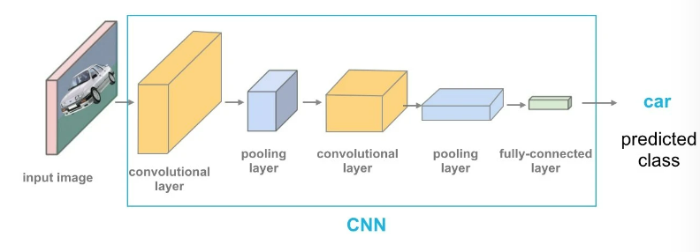
Stages Of Development Of Mask R-CNN
Stage 1: Convolutional Neural Network (CNN)
The building block in the task of computer vision for image recognition, processing, and segmentation.
It consists of three basic layers:
Convolutional Layer.
Pooling Layer.
Fully Connected Layer.
Figure ‎6: How a convolutional neural network works

Slide 22
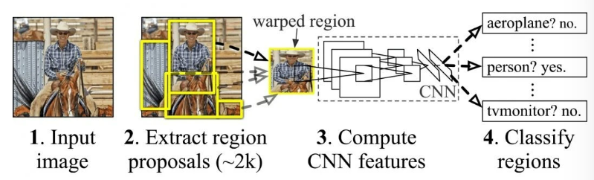
Stage 2: Region-Based Convolutional Networks (R-CNN)
An Improved version from CNN.
It places bounding boxes on the regions of the object.
These boxes evaluates the convolutional networks independently in all regions of interest (ROI).
classifies the regions of the object in the proposed category.
Figure ‎7: Concept of R-CNN – Region-based Convolutional Networks

Slide 23
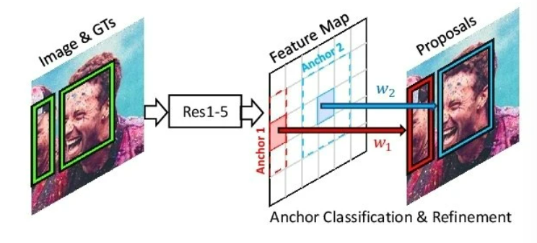
Stage 3: Faster R-CNN
An upgraded version of R-CNN.
It has two phases:
Region Proposal Network (RPN).
Figure 8: Concept of Region proposal Networks (RPN)

Slide 24
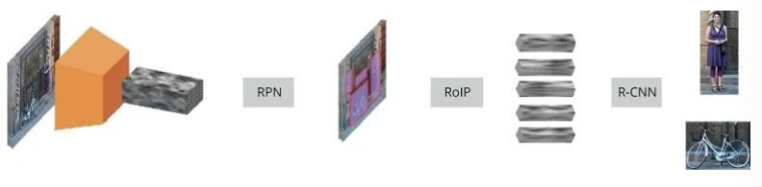
Fast R-CNN.
Figure ‎9: Faster R-CNN Stages

Slide 25
5. Mask R-CNN

Slide 26
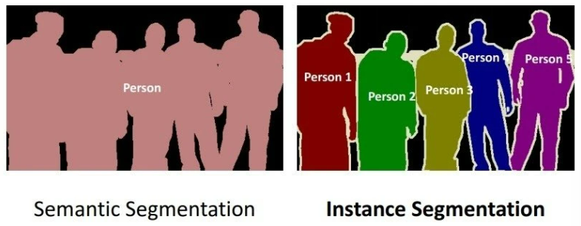
An upgraded version of Faster R-CNN.
The state-of-the-art in terms of image segmentation and instance segmentation.
Image Segmentation:
Semantic Segmentation
Instance Segmentation or Instance Recognition

Slide 27
Mask R-CNN adds a third branch to Faster R-CNN that produces the object mask.
The output requires a more accurate spatial layout extraction of the object.
A pre-built mask R-CNN model was used for book boundary detection.

Slide 28
6.
TEXT EXTRACTION

Slide 29
OpenCV
Open source library.
> 2500 algorithms in Computer Vision.
Artificial Intelligence.
Machine Learning.
Image processing.
Object detection, motion estimation and gesture detection.

Slide 30
Tesseract OCR Engine
Pick up printed/handwritten text from 2D images.
Convert to machine-readable text.
Preprocessing of the Image.
Text Localization.
Character Segmentation.
Character Recognition.
Post Processing.
Compatible with many programming languages and frameworks.
Python-tesseract/Pytesseract wrapper for python.

Slide 31
Image Pre-Processing Techniques
Rescaling
Convert a RGB image to a gray-scale image.
Binarization
Turn a gray-scale image to a black-and white image. (using gray-scale threshold).
Noise Removal
Remove noise from using filter. Replace pixel value with average of pixel around it.

Slide 32
Image Pre-Processing Techniques
Dilation
Expand the boundaries of foreground pixel areas (holes become smaller).
Erosion
Erode away the boundaries of areas of foreground pixels (holes become larger).
Opening
Erosion followed by dilation (remove the thin protrusions and internal noise from the image).

Slide 33
Image Pre-Processing Techniques
Closing
Dilation followed by erosion (erase the small holes, smoothen contours and fuse narrow breaks).
Contour Filtering
Curve that connects all continuous points (along the border) that have the same color or intensity.
Background and Text coloring
Change the color of the background into white and the color of the text to black.

Slide 34
7.
SIMULATED RESULTS

Slide 35
The mask R-CNN model was first applied on our dataset of bookshelves images, then the image pre-processing and text extraction algorithm.
The result obtained are:

Slide 36
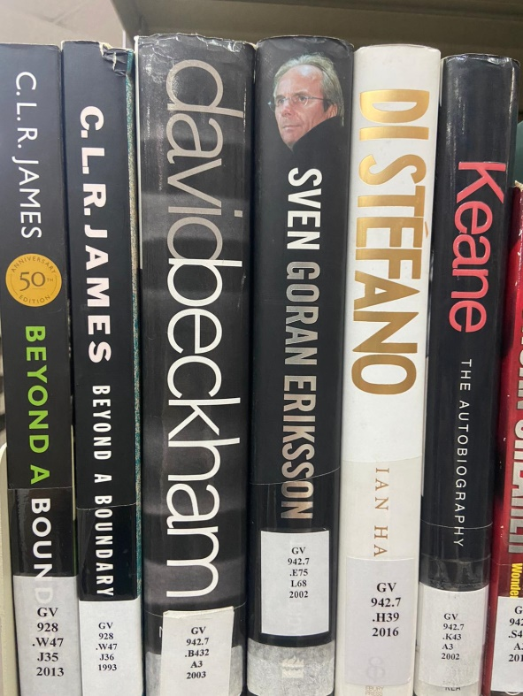
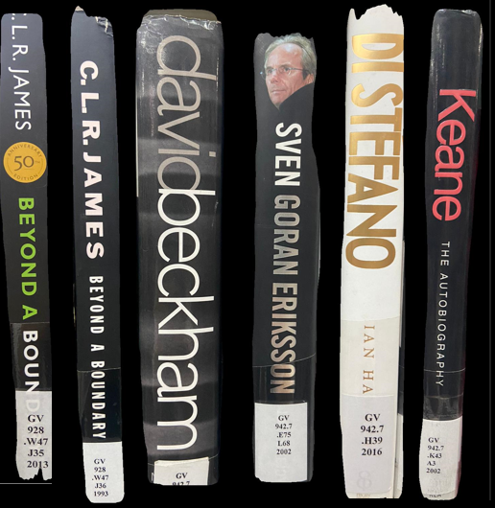
Mask-RCNN Model and Text Extraction Results
For Vertical Books:
Step1

Slide 37
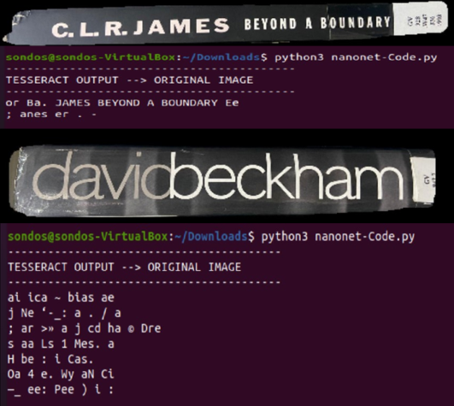
Mask-RCNN Model and Text Extraction Results
For Vertical Books:
Step2

Slide 38
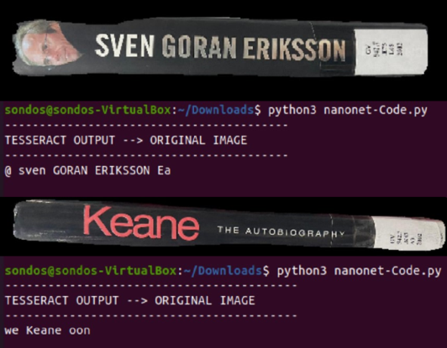
Mask-RCNN Model and Text Extraction Results
For Vertical Books:
Step2

Slide 39
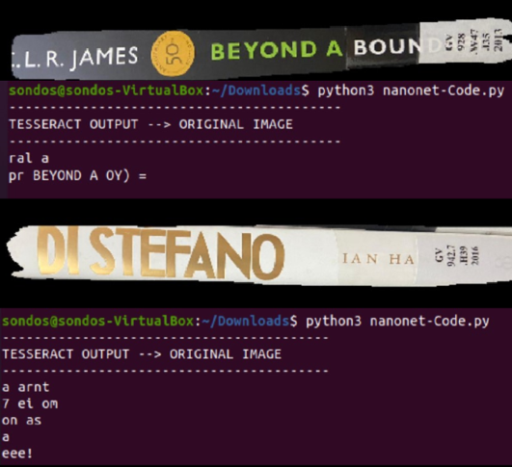
Mask-RCNN Model and Text Extraction Results
For Vertical Books:
Step2

Slide 40
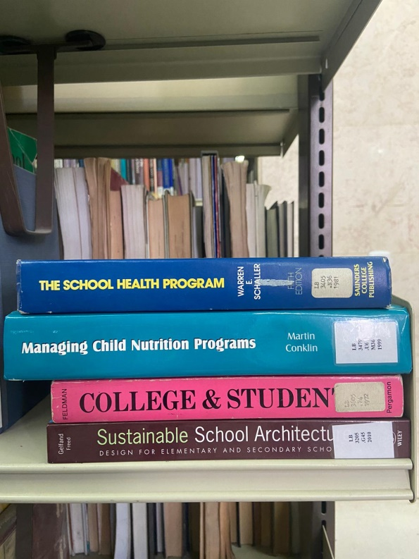
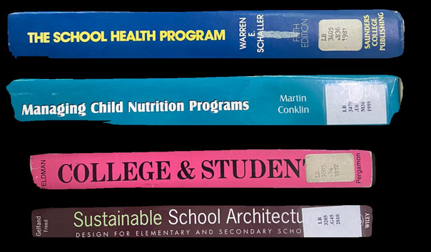
Mask-RCNN Model and Text Extraction Results
For Horizontal Books:
Step1

Slide 41
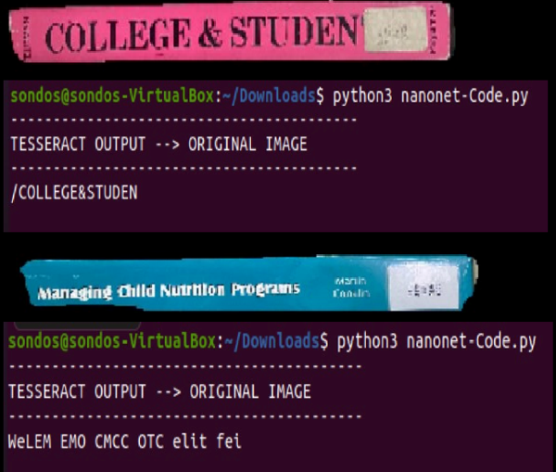
Mask-RCNN Model and Text Extraction Results
For Horizontal Books:
Step2

Slide 42
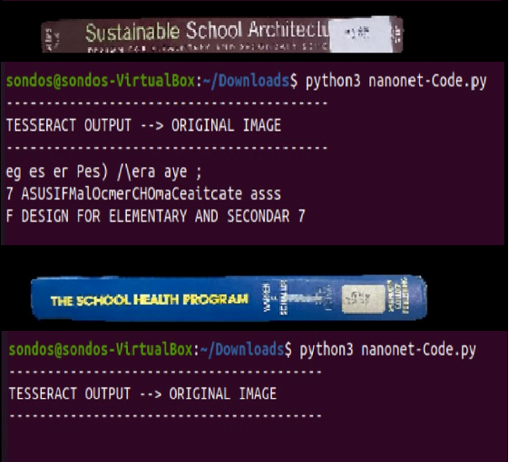
Mask-RCNN Model and Text Extraction Results
For Horizontal Books:
Step2

Slide 43
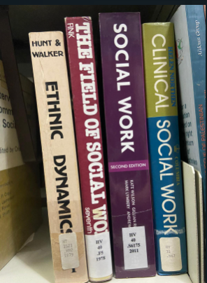
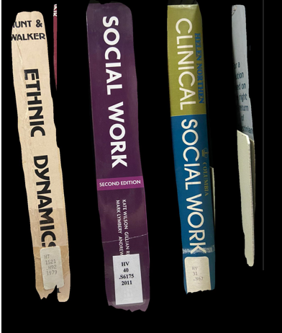
Mask-RCNN Model and Text Extraction Results
For Slant Books (about 10°):
Step1

Slide 44
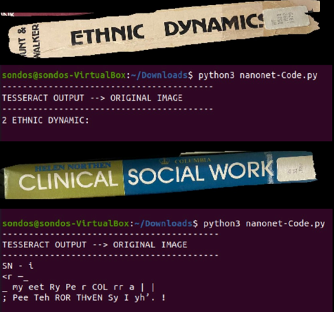
Mask-RCNN Model and Text Extraction Results
For Slanted Books (about 10°):
Step2

Slide 45
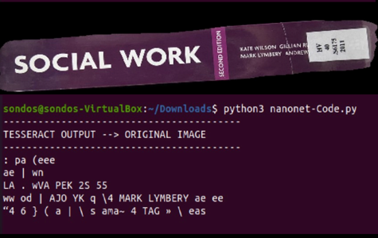
Mask-RCNN Model and Text Extraction Results
For Slanted Books (about 10°):
Step2

Slide 46
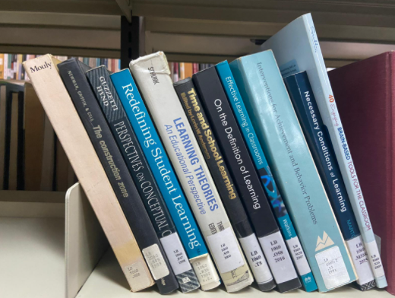
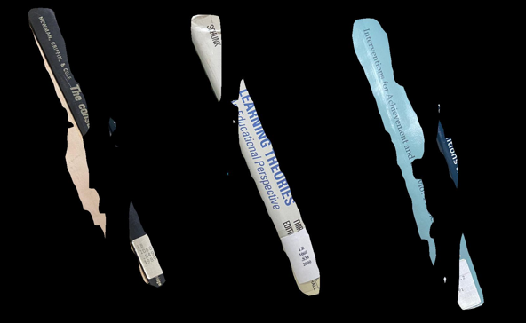
Mask-RCNN Model and Text Extraction Results
For Slanted Books (more than 10°):
Step1

Slide 47
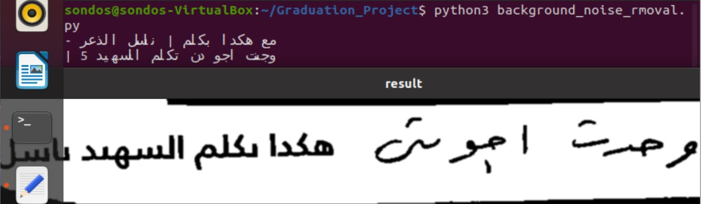
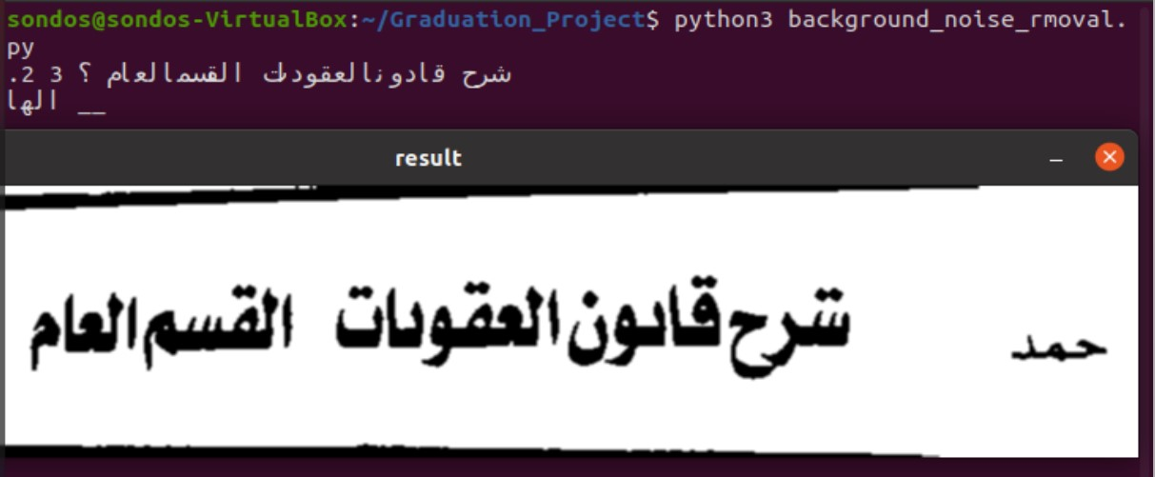
Mask-RCNN Model and Text Extraction Results
Arabic Titles Books

Slide 48
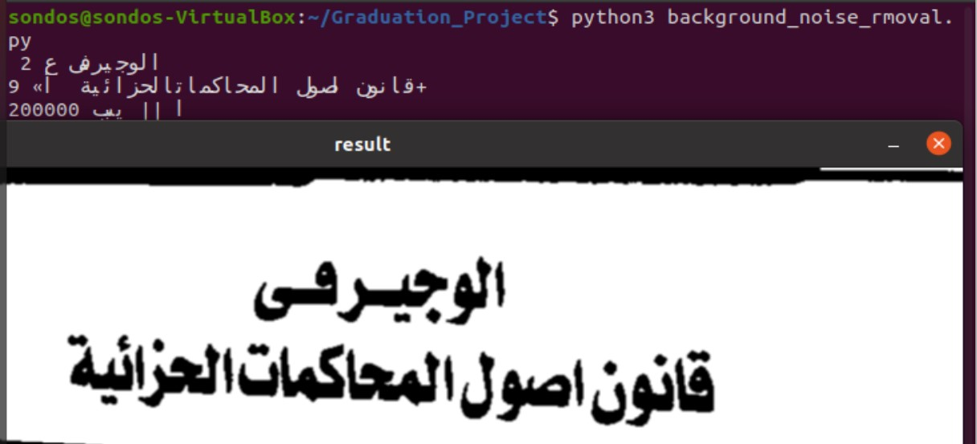
Mask-RCNN Model and Text Extraction Results
Arabic Titles Books

Slide 49
Results Accuracy
Accuracy of Mask R-CNN Model:
For vertical books = 97%.
For horizontal books = 95%.
For slanted books = 47%.
Accuracy of Tesseract OCR:
For English titles = 66.5%.
For Arabic titles = 53.2%.

Slide 50
8.
CONCLUSION

Slide 51
Conclusion
Learning new concepts.
Discuss python codes on OCR.
Studying Mask R-CNN Model and put it under test.
Team work and time management.

Slide 52
Limitations
Bad quality of image (size, contrast and lightening).
Vertical format book title.
Not supported languages.
Tesseract does not support some special fonts.
The enhancement on the image caused some letters losing some of its parts like dots.
The organization in the library itself.

Slide 53
Future Work
Enhance R-CNN Model accuracy.
Slanted books boundaries detection issue should be resolved.
Add more languages to the text extraction algorithm.
Build an efficient manipulator.

Slide 54
Copy Percentage 25%

Slide 55
Thanks!
Any questions?

